Slide 1
Eye Movements Classification Monkey: Gandalf

Slide 2
Glitch Total: 12

Slide 3
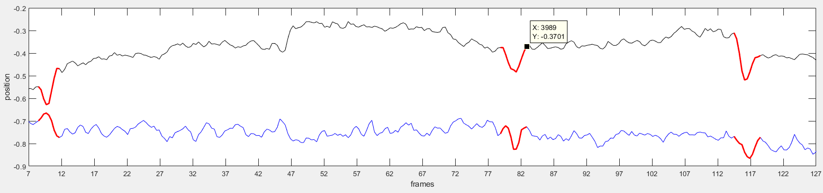
Glitch num. 1
Cortex Trial | CondsX1 Trial | Onset Frame | Offset Frame | Amp (max) | Direction (vecAverage) | Velocity
9 | 2 | 78 | 83 | 0.15 | 9.74 | 10.08
Time Course Figure

Slide 4
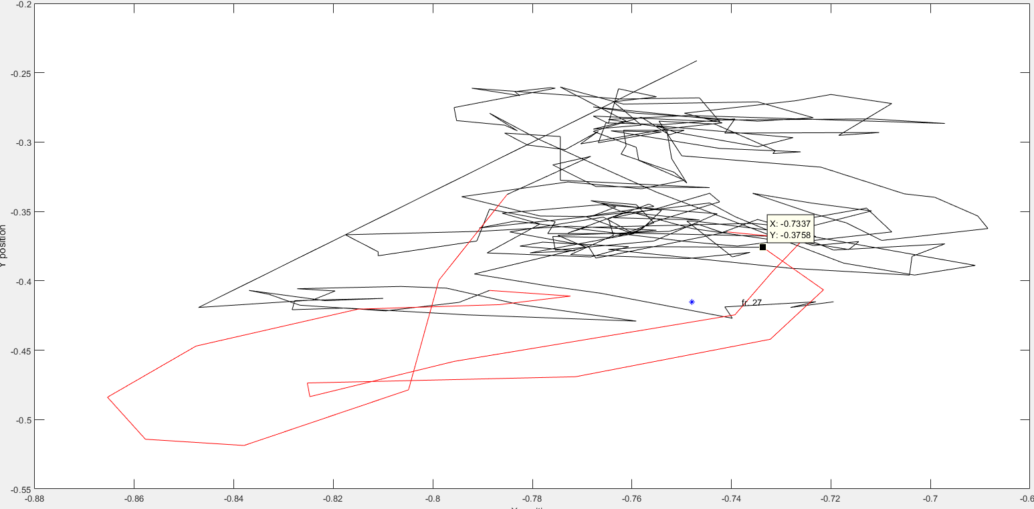
Glitch num. 1
Spatial EM

Slide 5
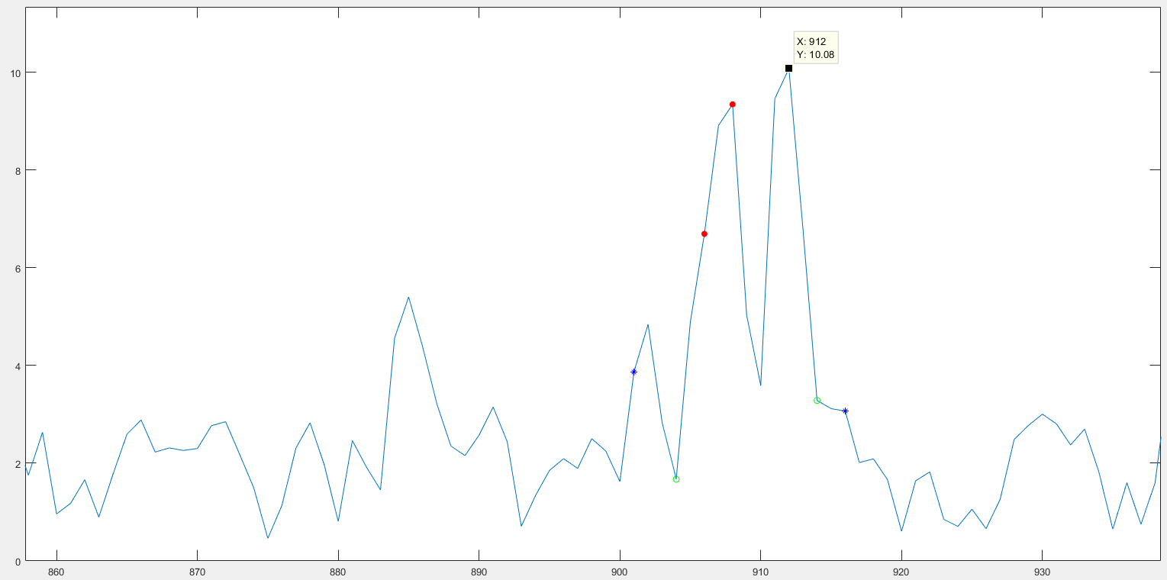
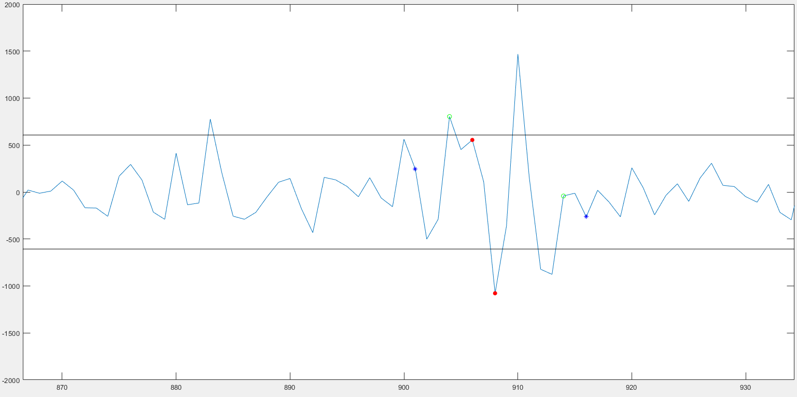
Glitch num. 1
Velocity Vector
Acceleration Vector

Slide 6
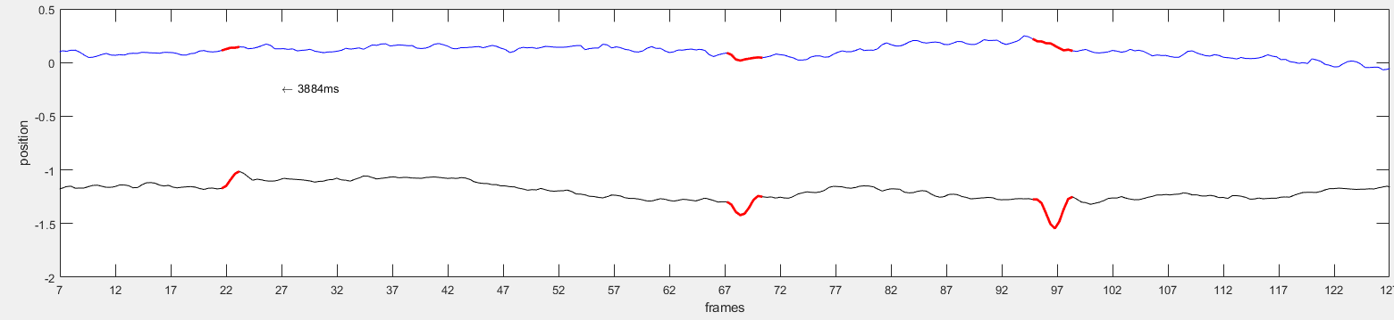
Glitch num. 2
Cortex Trial | CondsX1 Trial | Onset Frame | Offset Frame | Amp (max) | Direction (vecAverage) | Velocity
69 | 8 | 67 | 70 | 0.19 | 133.78 | 12.89
Time Course Figure

Slide 7
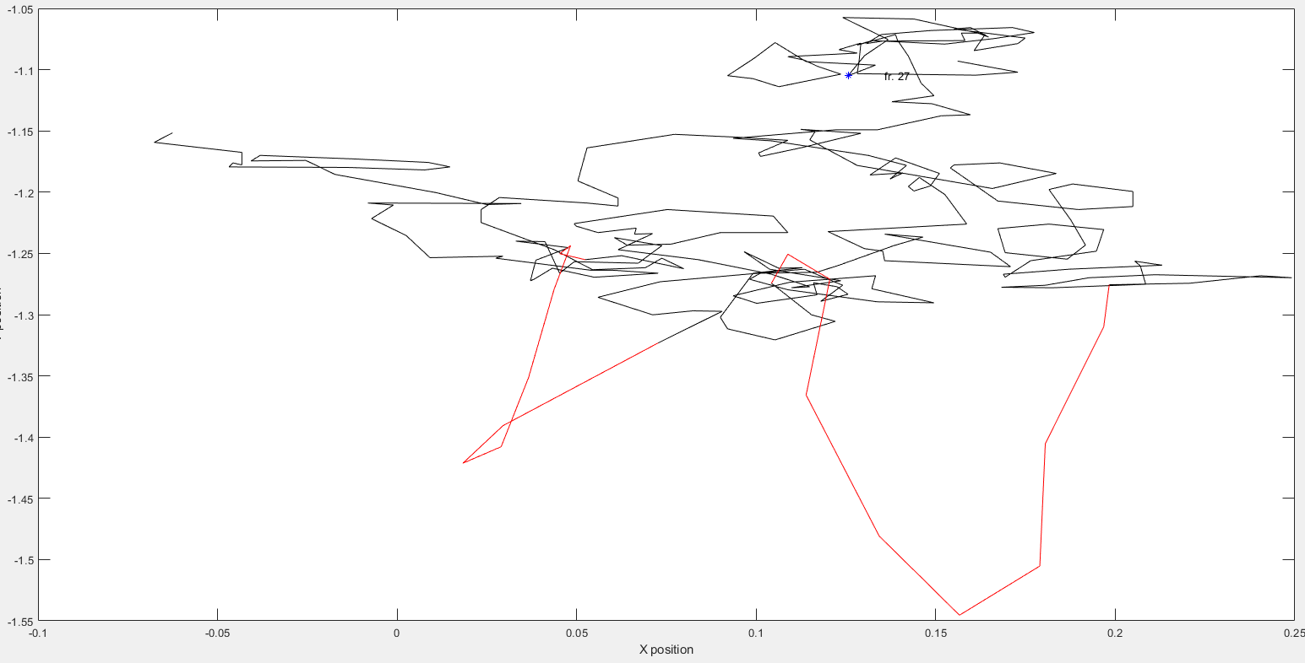
Glitch num. 2
Spatial EM

Slide 8
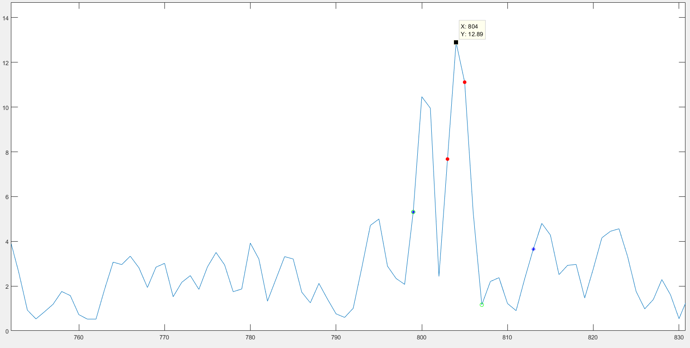
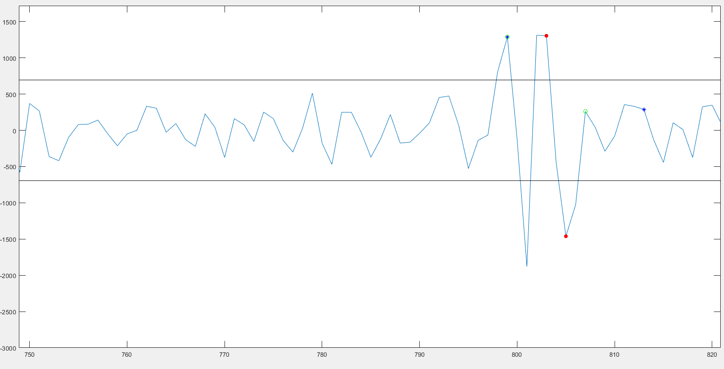
Glitch num. 2
Velocity Vector
Acceleration Vector

Slide 9
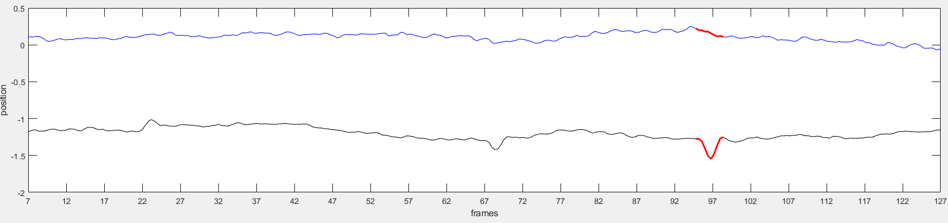
Glitch num. 3
Cortex Trial | CondsX1 Trial | Onset Frame | Offset Frame | Amp (max) | Direction (vecAverage) | Velocity
69 | 8 | 94 | 98 | 0.32 | 183.05 | 21.17
Time Course Figure

Slide 10
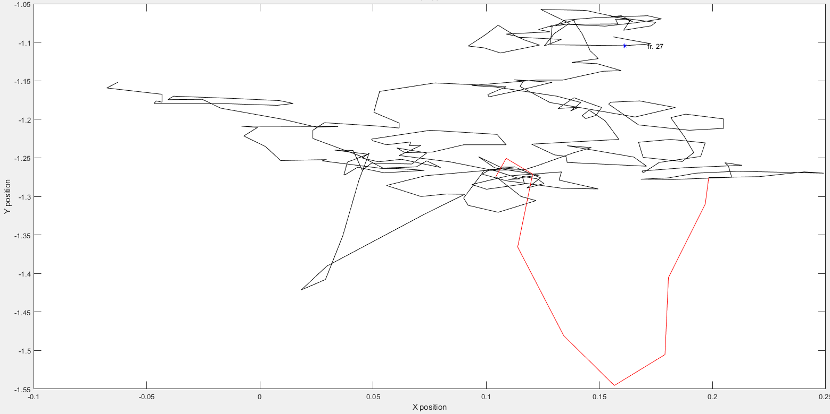
Glitch num. 3
Spatial EM

Slide 11
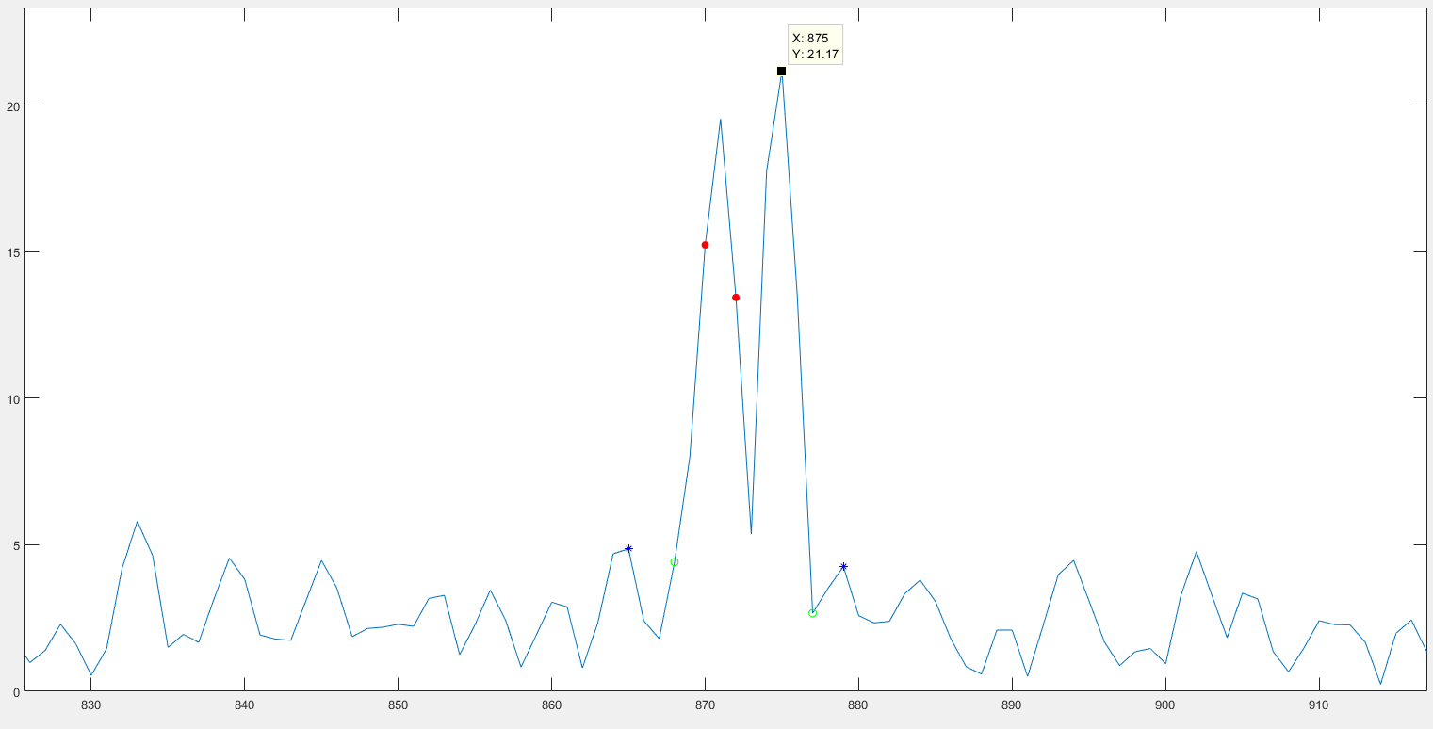
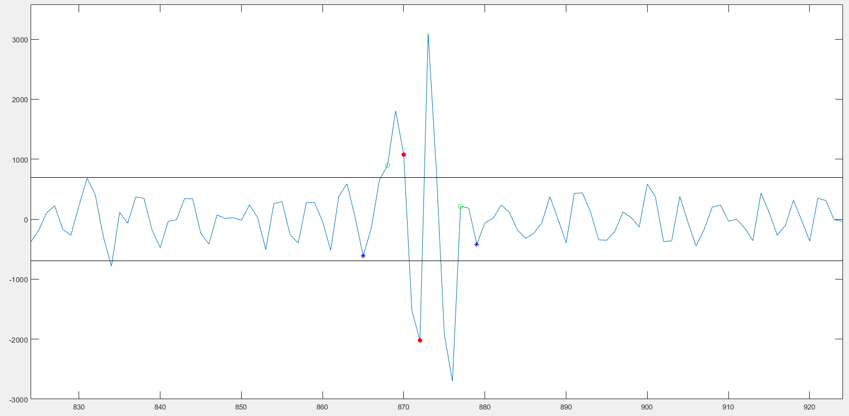
Glitch num. 3
Velocity Vector
Acceleration Vector

Slide 12
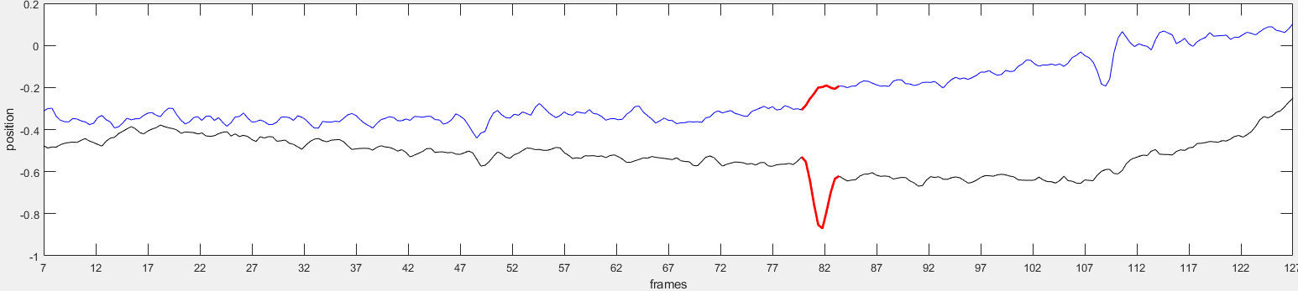
Glitch num. 4
Cortex Trial | CondsX1 Trial | Onset Frame | Offset Frame | Amp (max) | Direction (vecAverage) | Velocity
76 | 9 | 79 | 83 | 0.36 | -47.2 | 22.98
Time Course Figure

Slide 13
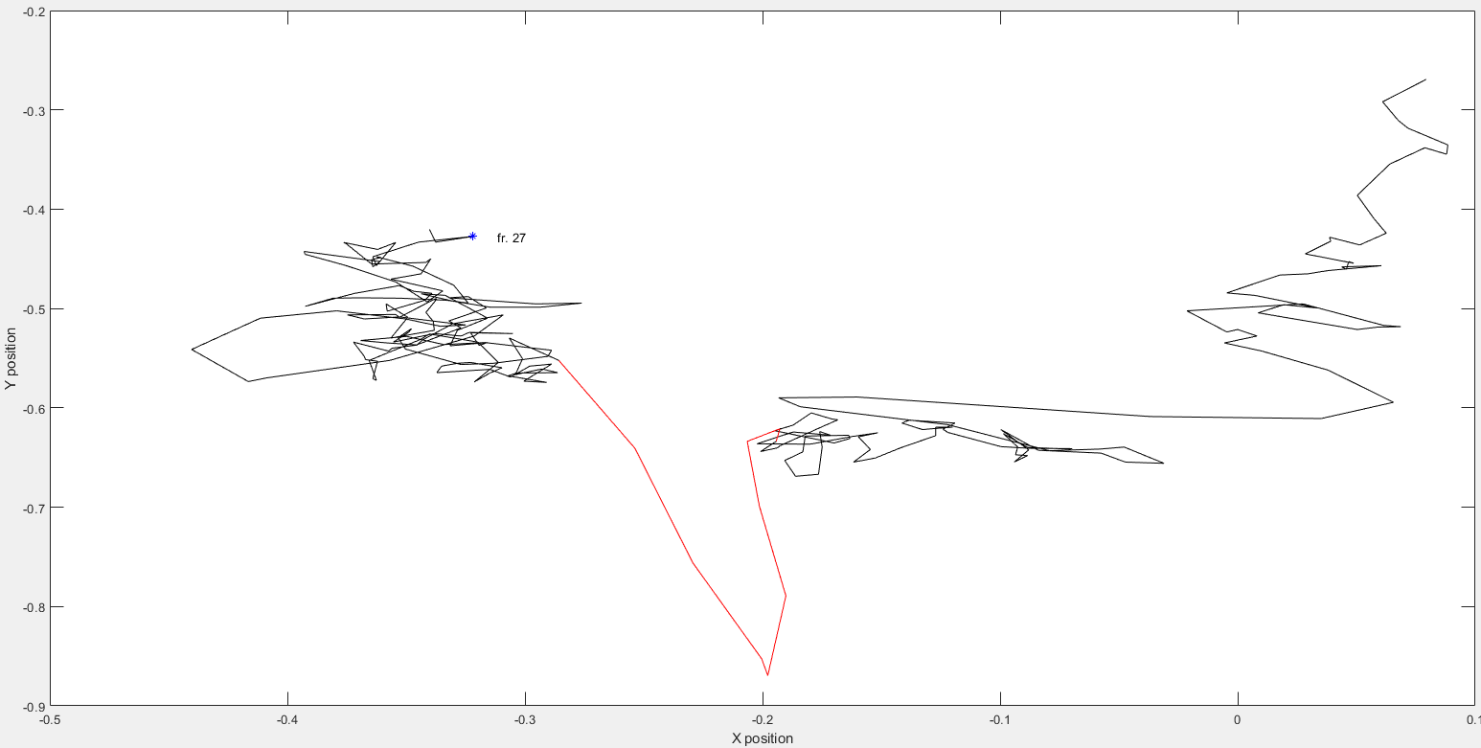
Glitch num. 4
Spatial EM

Slide 14
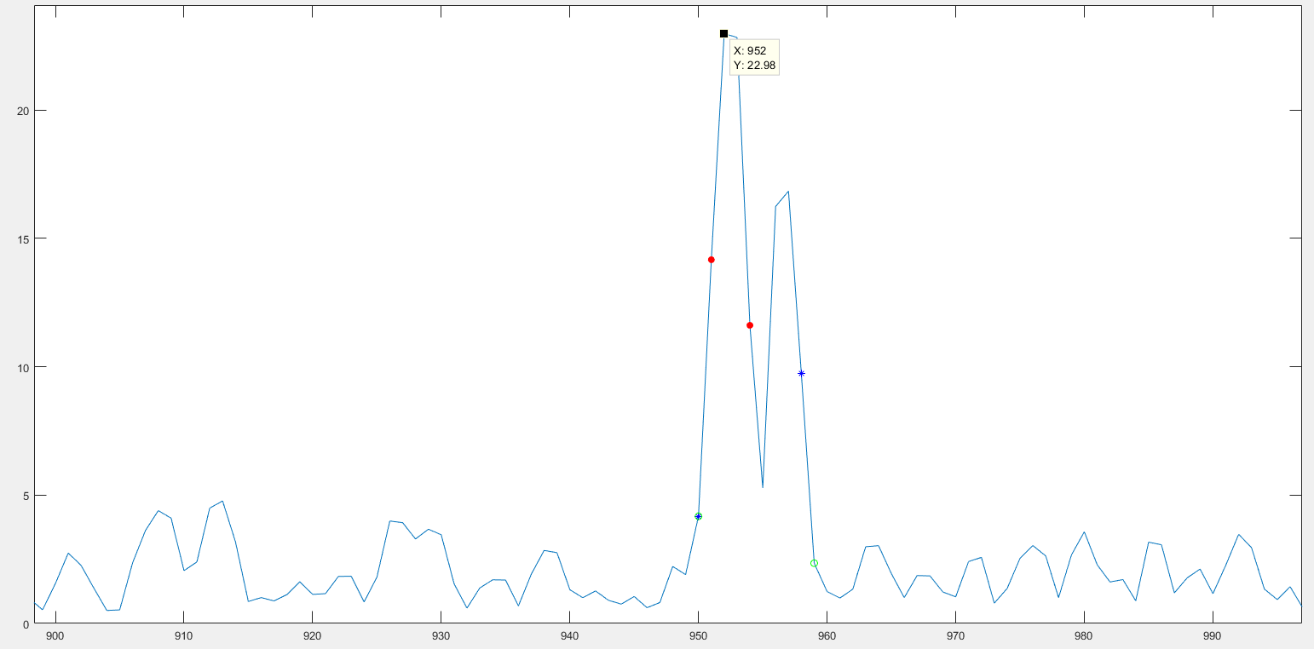
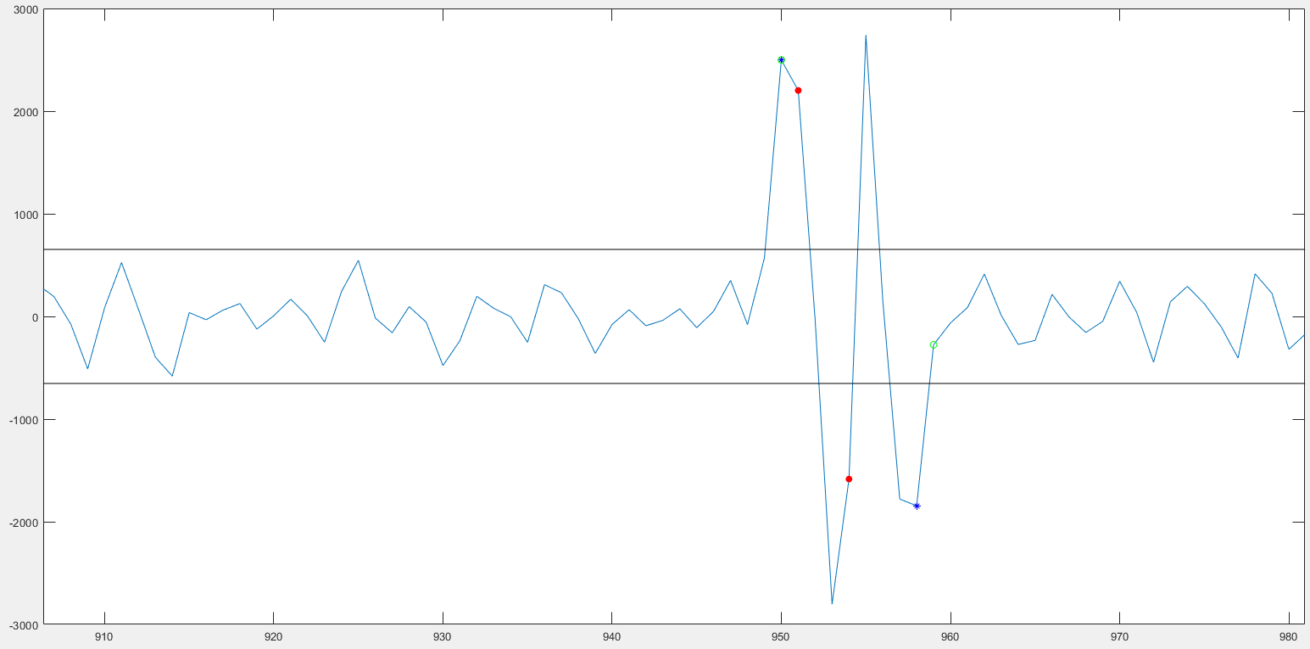
Glitch num. 4
Velocity Vector
Acceleration Vector

Slide 15
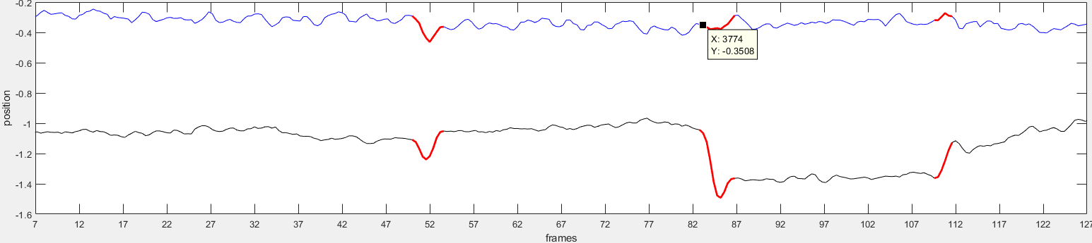
Glitch num. 5
Cortex Trial | CondsX1 Trial | Onset Frame | Offset Frame | Amp (max) | Direction (vecAverage) | Velocity
97 | 11 | 50 | 53 | 0.25 | 138.86 | 13.89
Time Course Figure

Slide 16
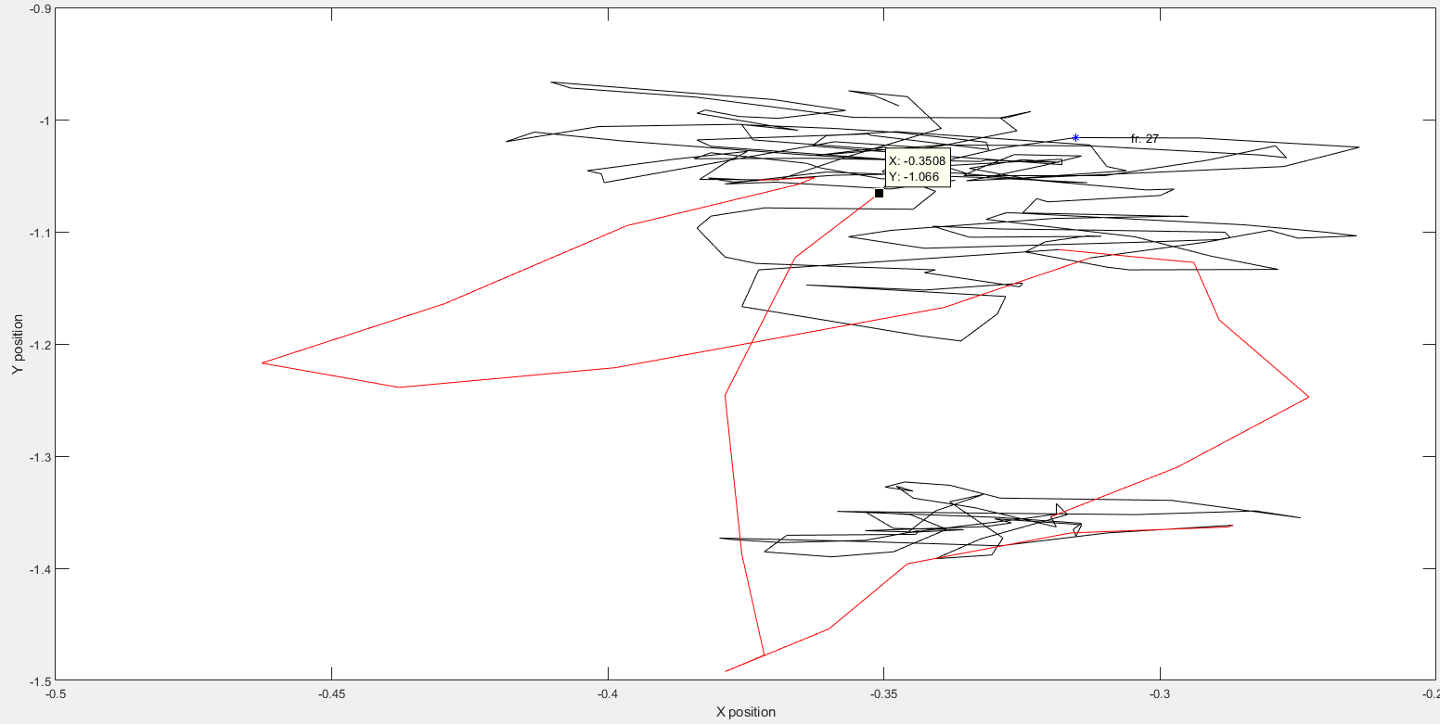
Glitch num. 5
Spatial EM

Slide 17
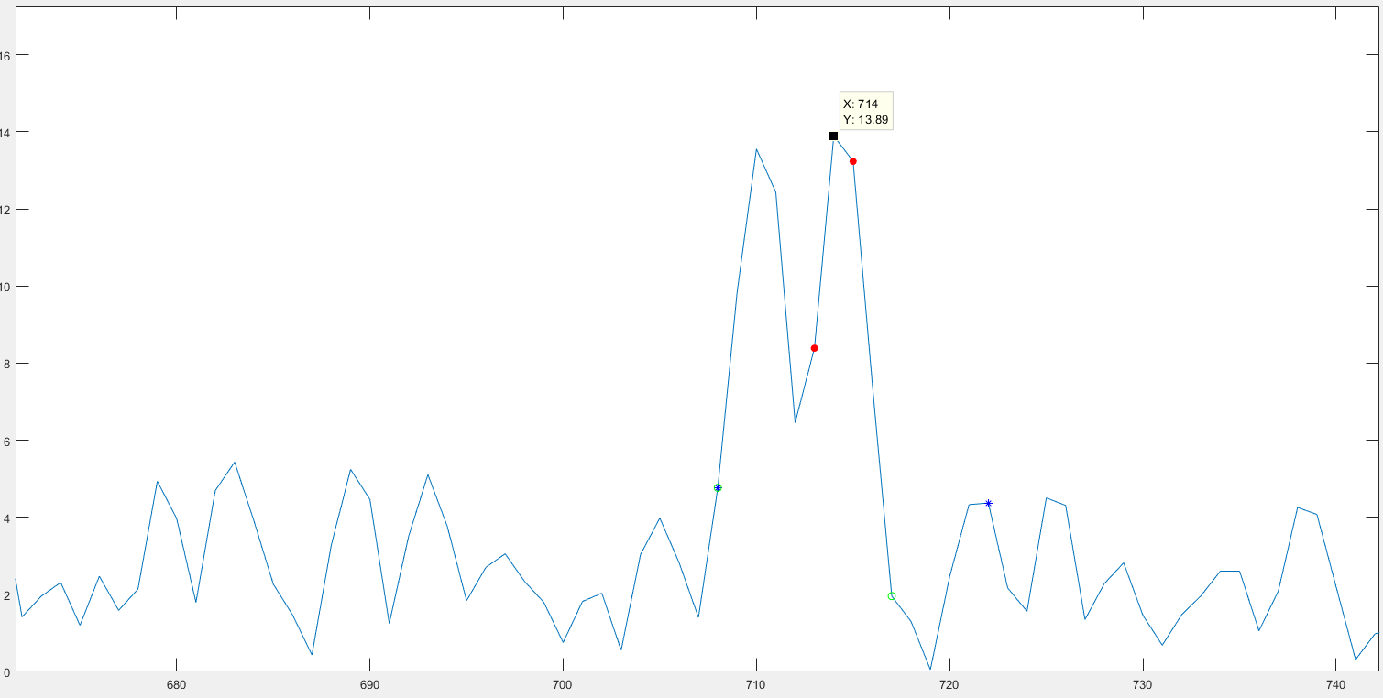
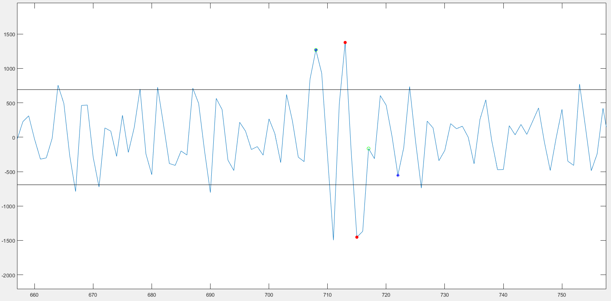
Glitch num. 5
Velocity Vector
Acceleration Vector

Slide 18
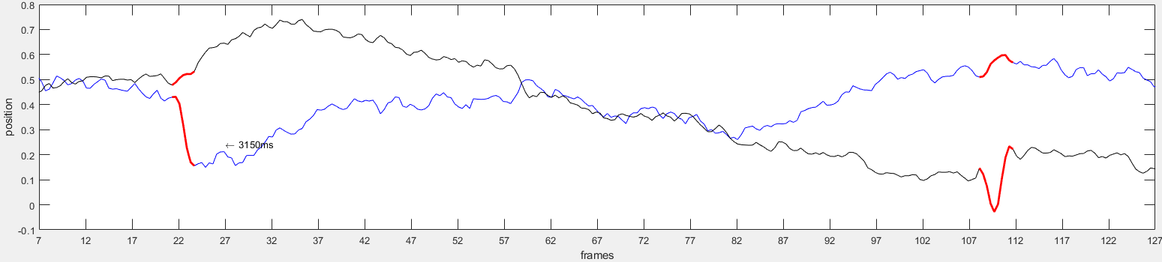
Glitch num. 6
Cortex Trial | CondsX1 Trial | Onset Frame | Offset Frame | Amp (max) | Direction (vecAverage) | Velocity
198 | 19 | 108 | 111 | 0.26 | 60.98 | 18.65
Time Course Figure

Slide 19
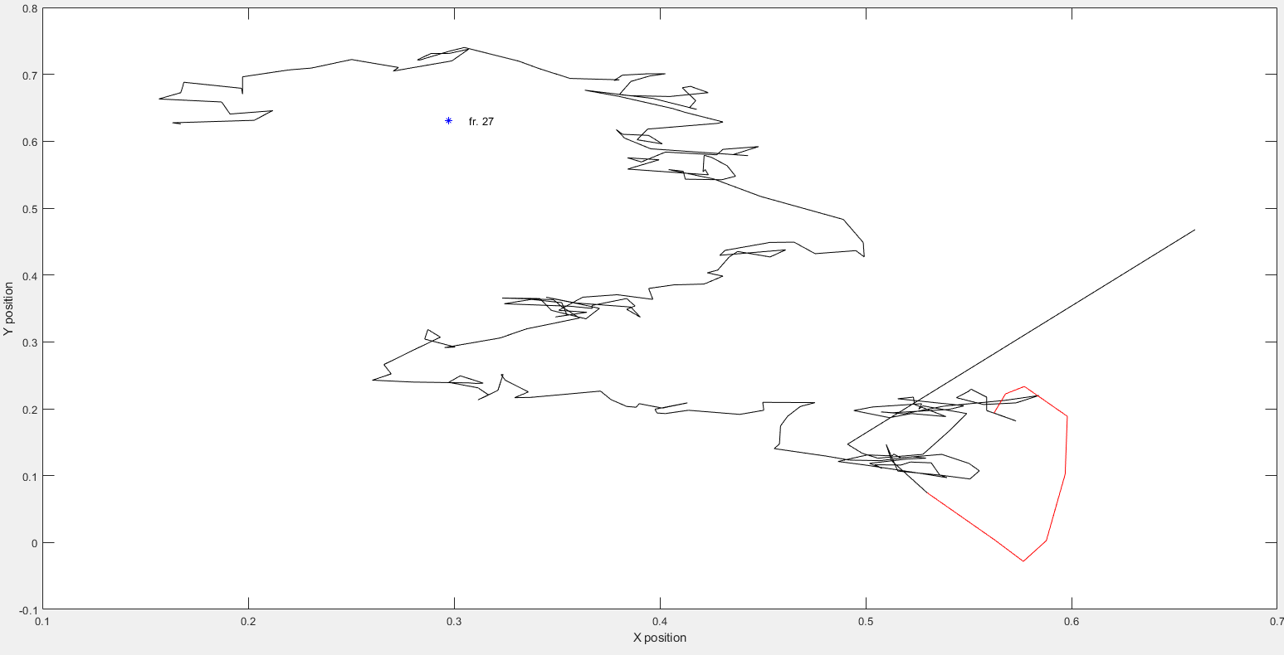
Glitch num. 6
Spatial EM

Slide 20
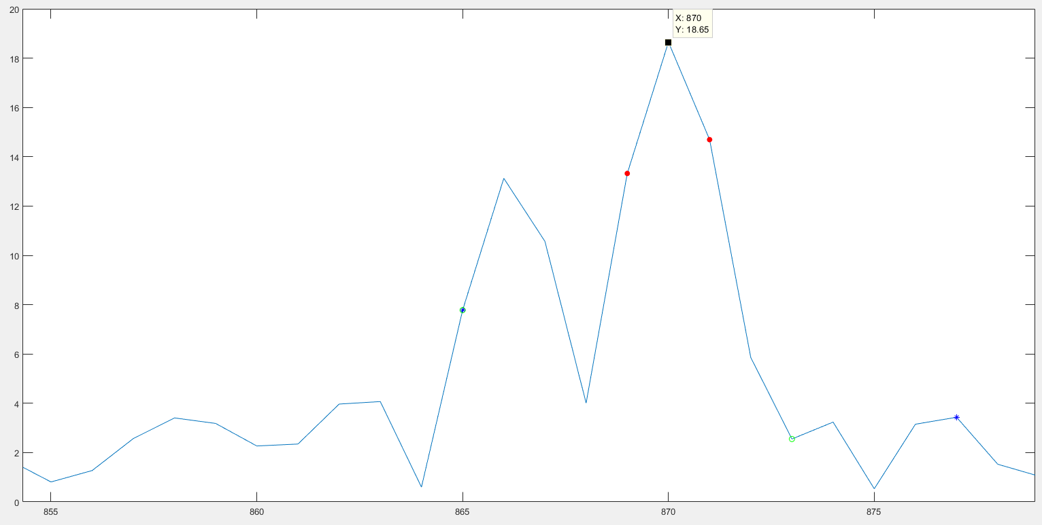
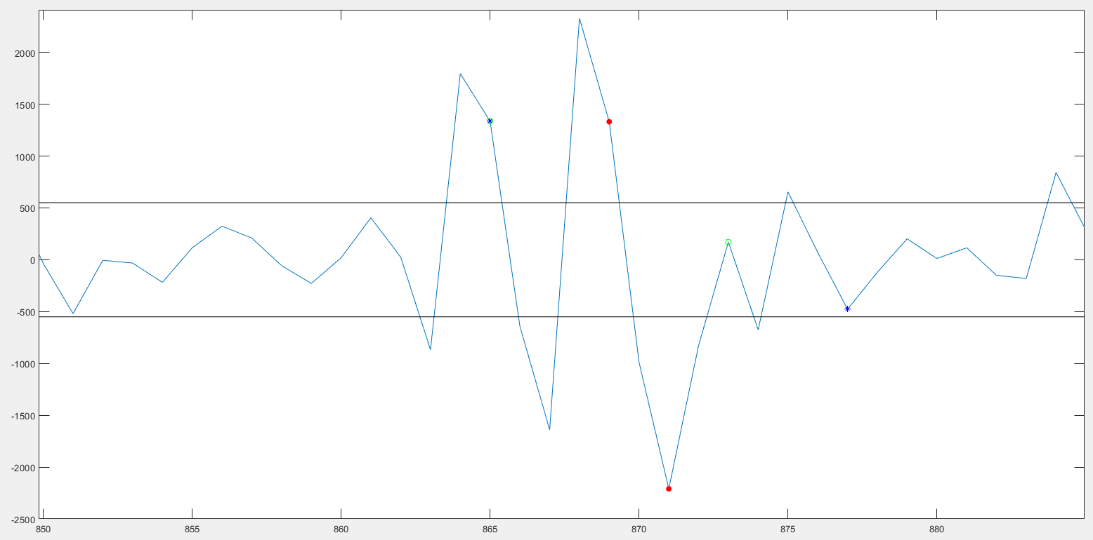
Glitch num. 6
Velocity Vector
Acceleration Vector

Slide 21
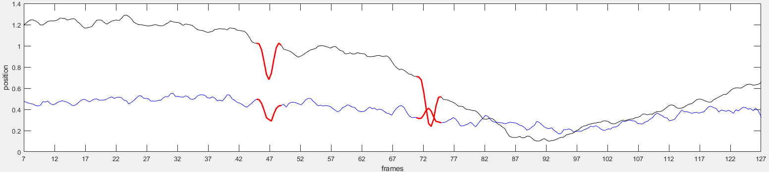
Glitch num. 7
Cortex Trial | CondsX1 Trial | Onset Frame | Offset Frame | Amp (max) | Direction (vecAverage) | Velocity
218 | 20 | 70 | 74 | 0.49 | 255.27 | 31
Time Course Figure

Slide 22
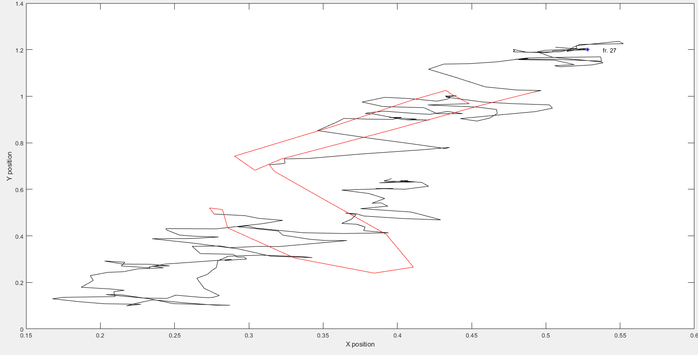
Glitch num. 7
Spatial EM

Slide 23
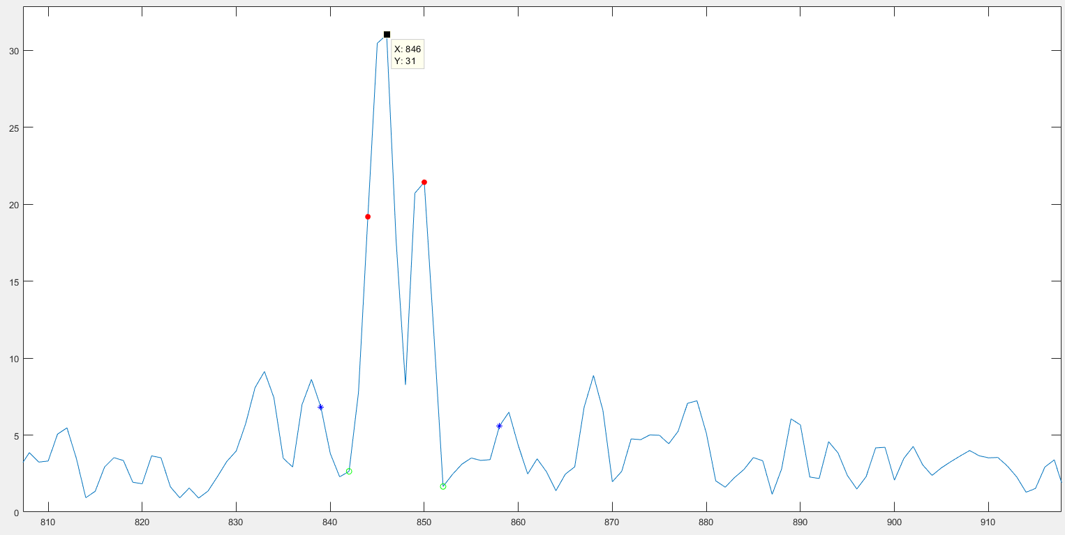
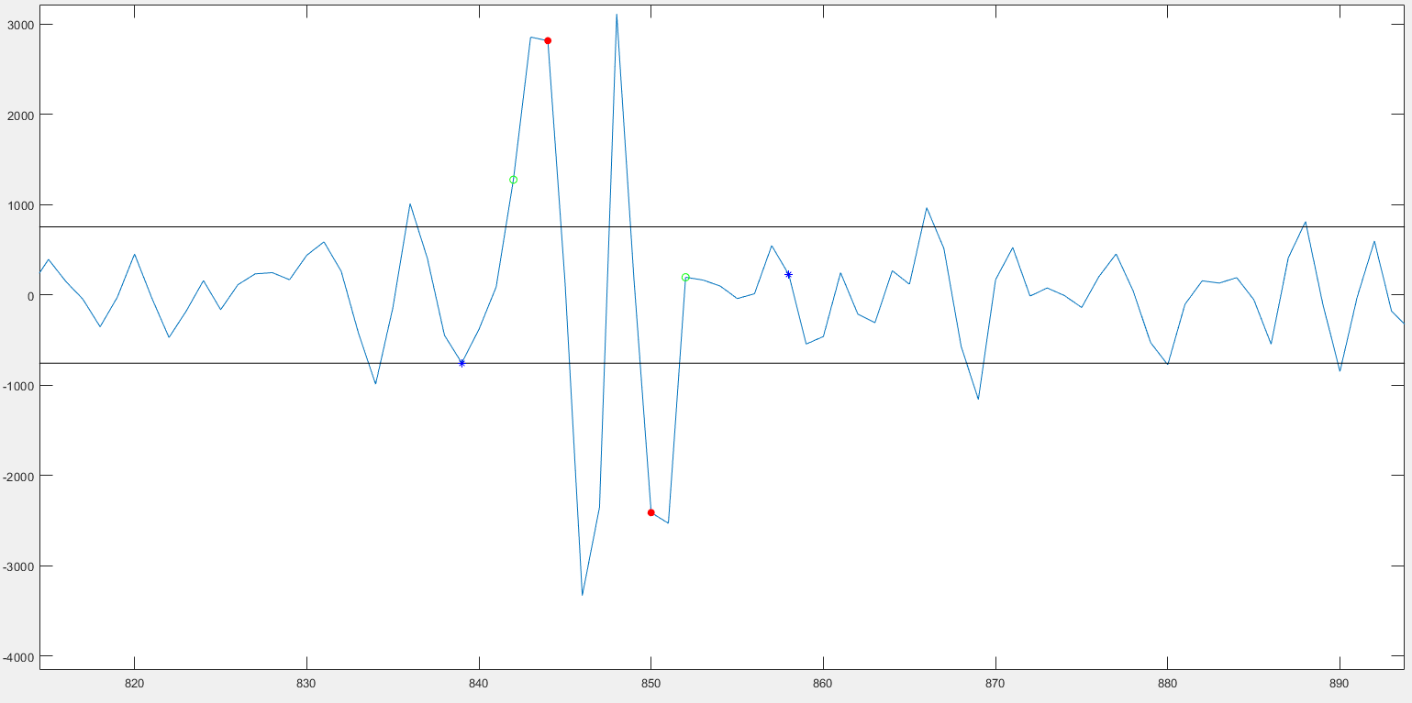
Glitch num. 7
Velocity Vector
Acceleration Vector

Slide 24
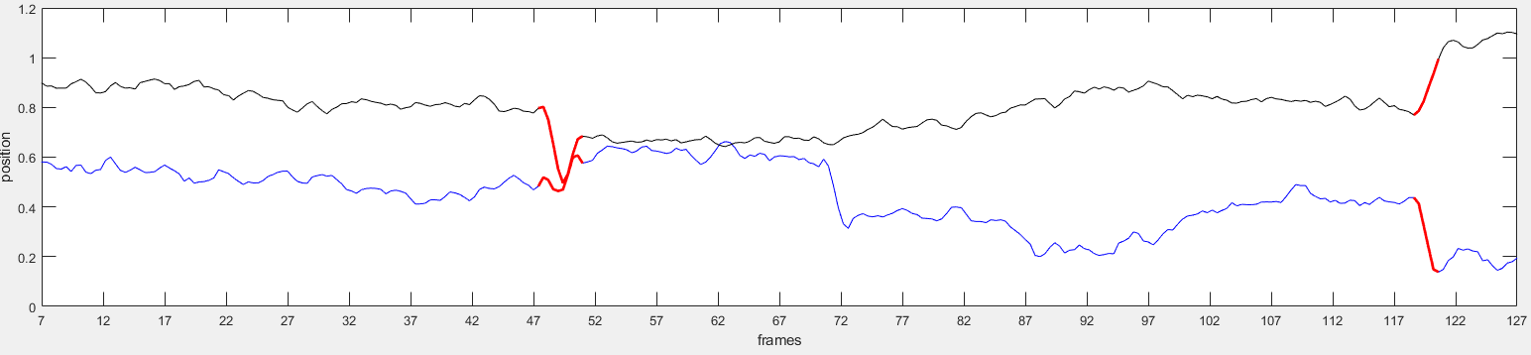
Glitch num. 8
Cortex Trial | CondsX1 Trial | Onset Frame | Offset Frame | Amp (max) | Direction (vecAverage) | Velocity
240 | 22 | 47 | 51 | 0.34 | -50.48 | 21.36
Time Course Figure

Slide 25
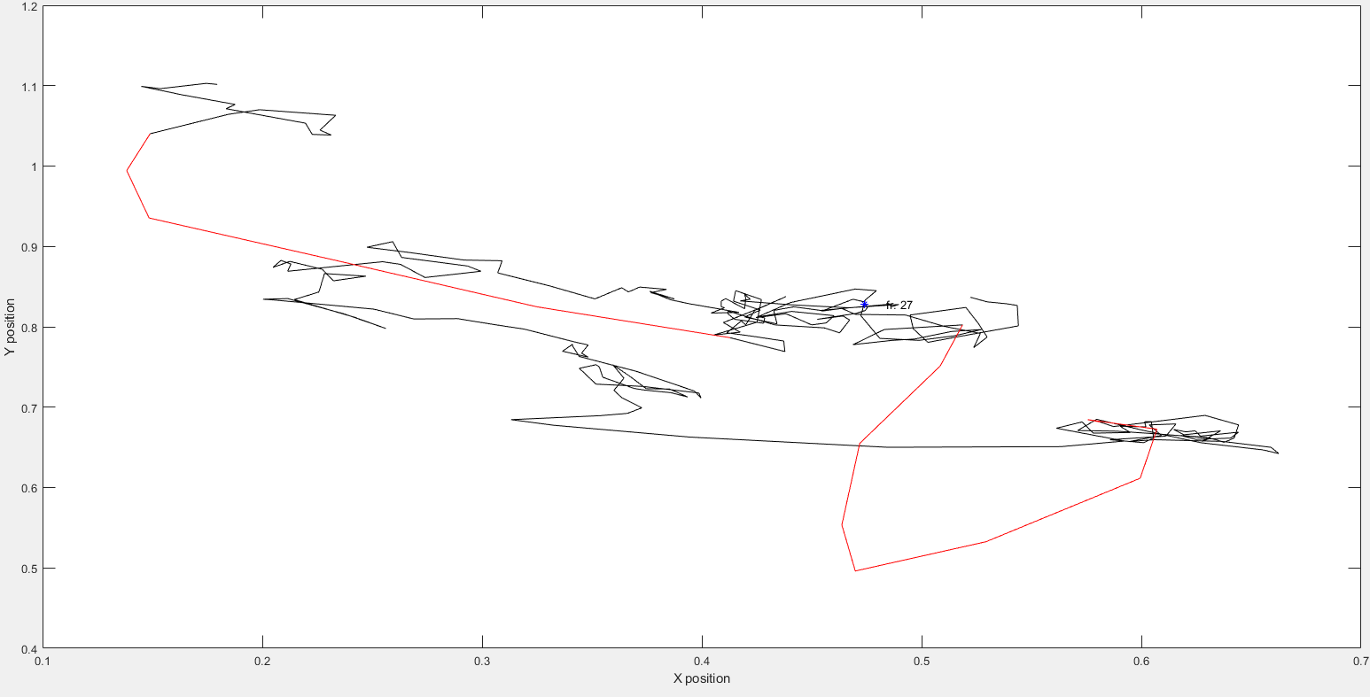
Glitch num. 8
Spatial EM

Slide 26
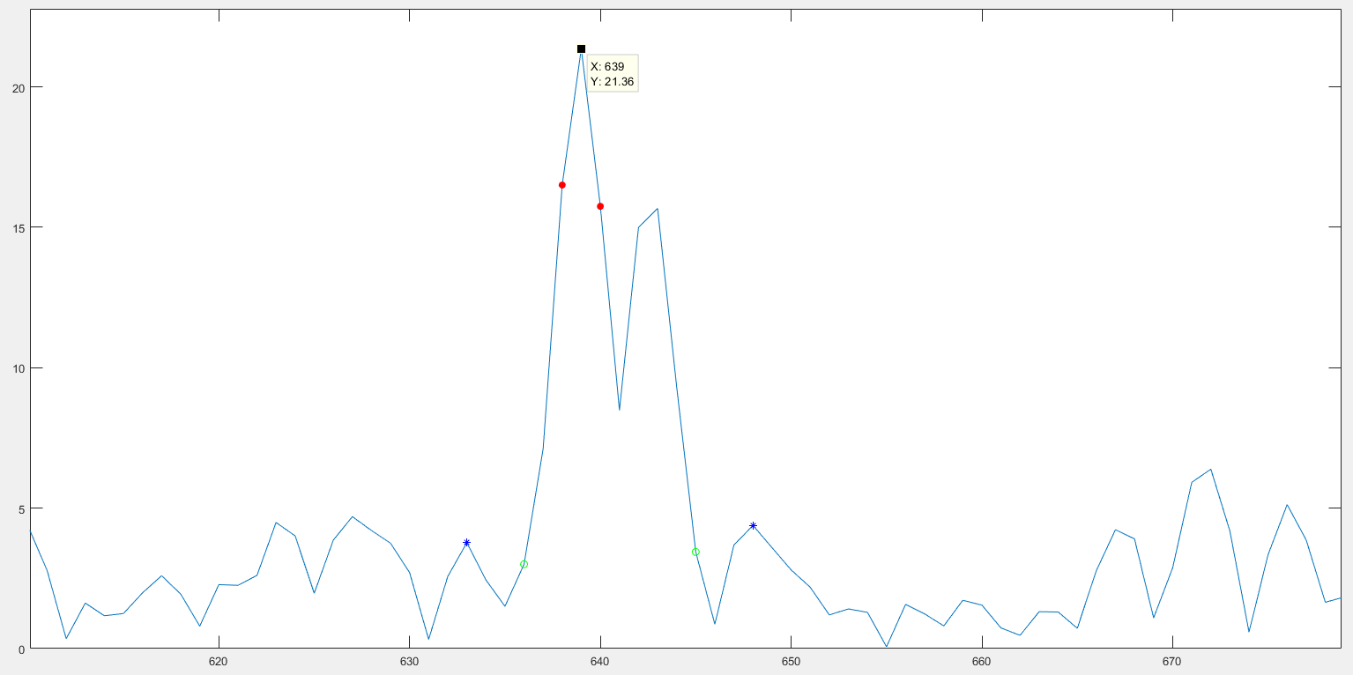
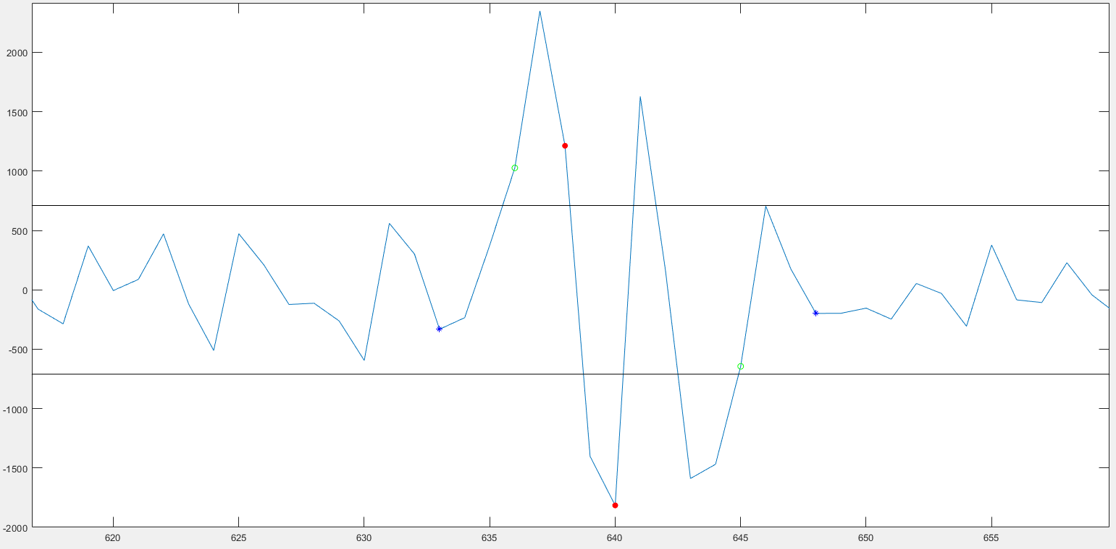
Glitch num. 8
Velocity Vector
Acceleration Vector

Slide 27
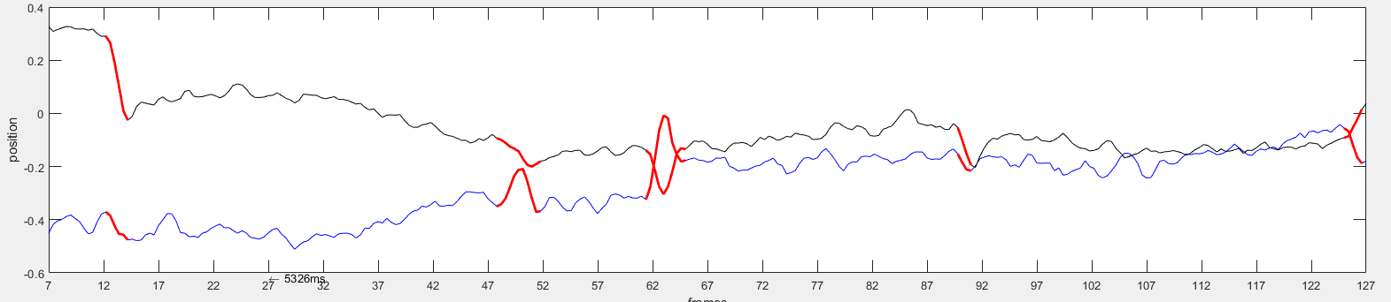
Glitch num. 9
Cortex Trial | CondsX1 Trial | Onset Frame | Offset Frame | Amp (max) | Direction (vecAverage) | Velocity
271 | 25 | 47 | 52 | 0.19 | 258 | 11.58
Time Course figure:

Slide 28
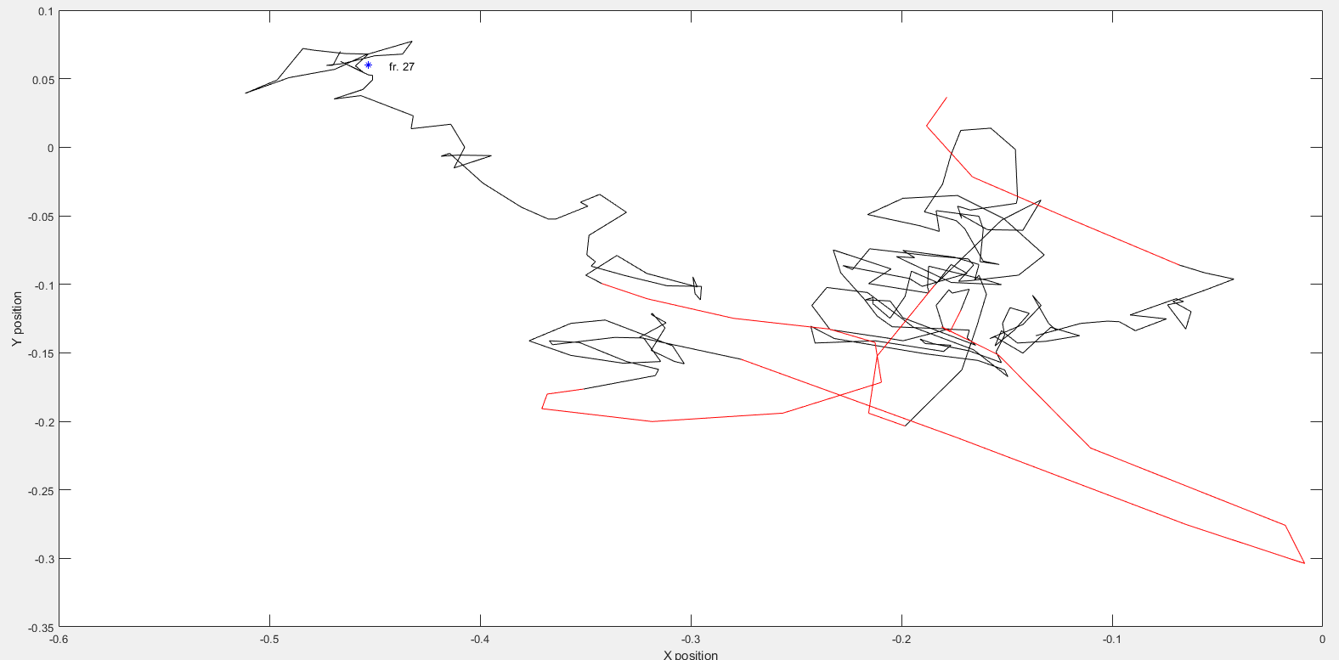
Glitch num. 9
Spatial EM

Slide 29
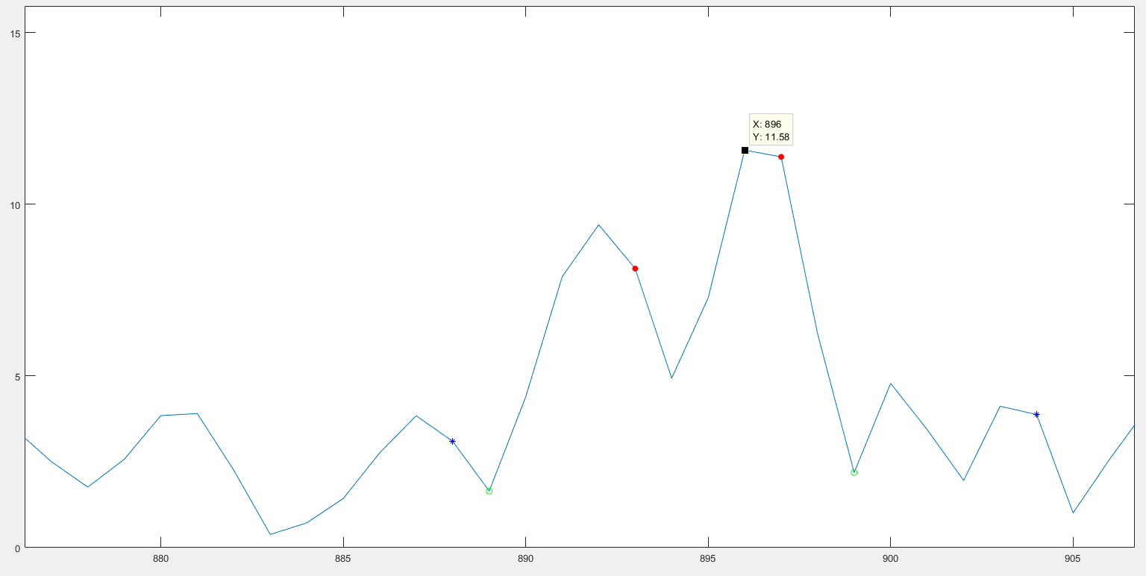
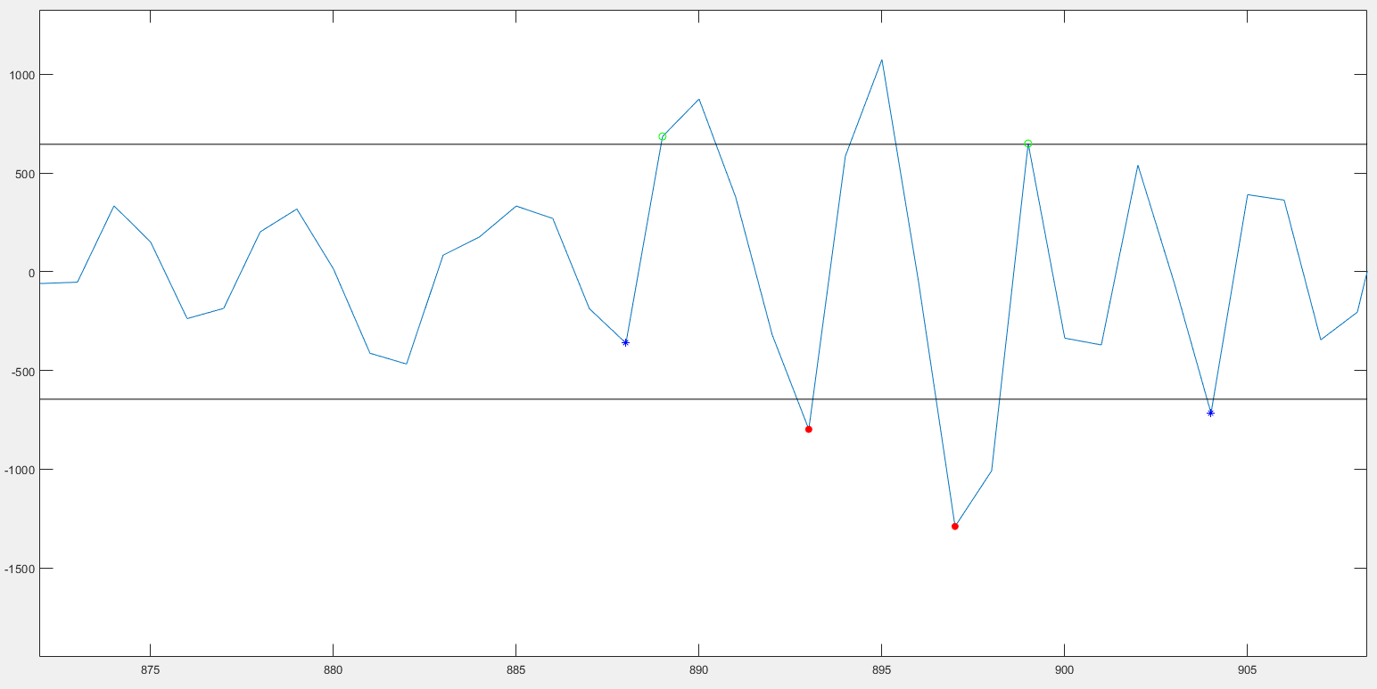
Glitch num. 9
Velocity Vector
Acceleration Vector

Slide 30
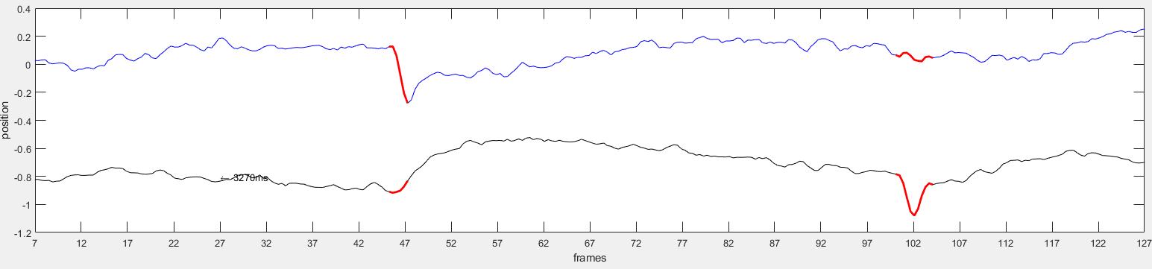
Glitch num. 10
Cortex Trial | CondsX1 Trial | Onset Frame | Offset Frame | Amp (max) | Direction (vecAverage) | Velocity
357 | 34 | 45 | 47 | 0.49 | 124.07 | 28.35
Time Course Figure

Slide 31
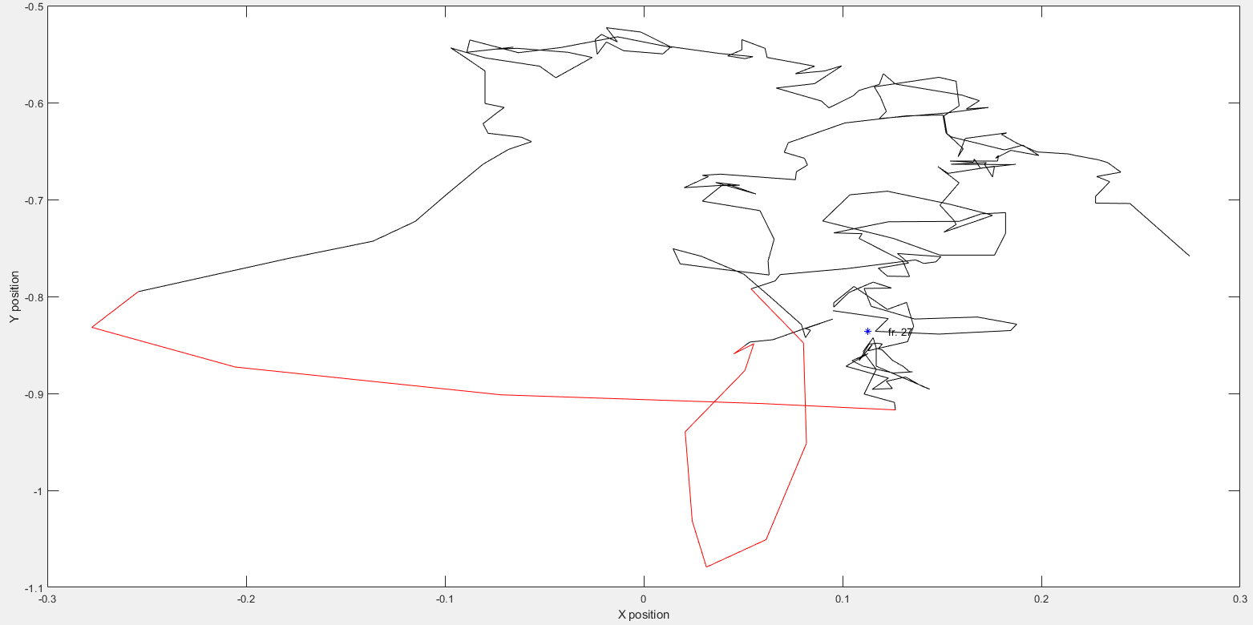
Glitch num. 10
Spatial EM

Slide 32
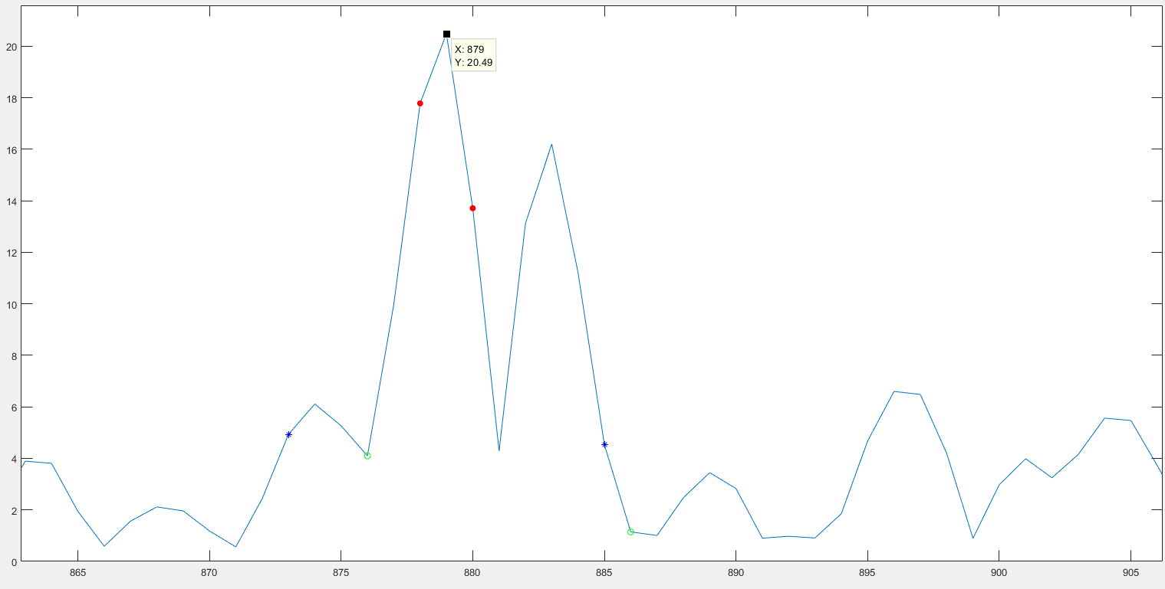
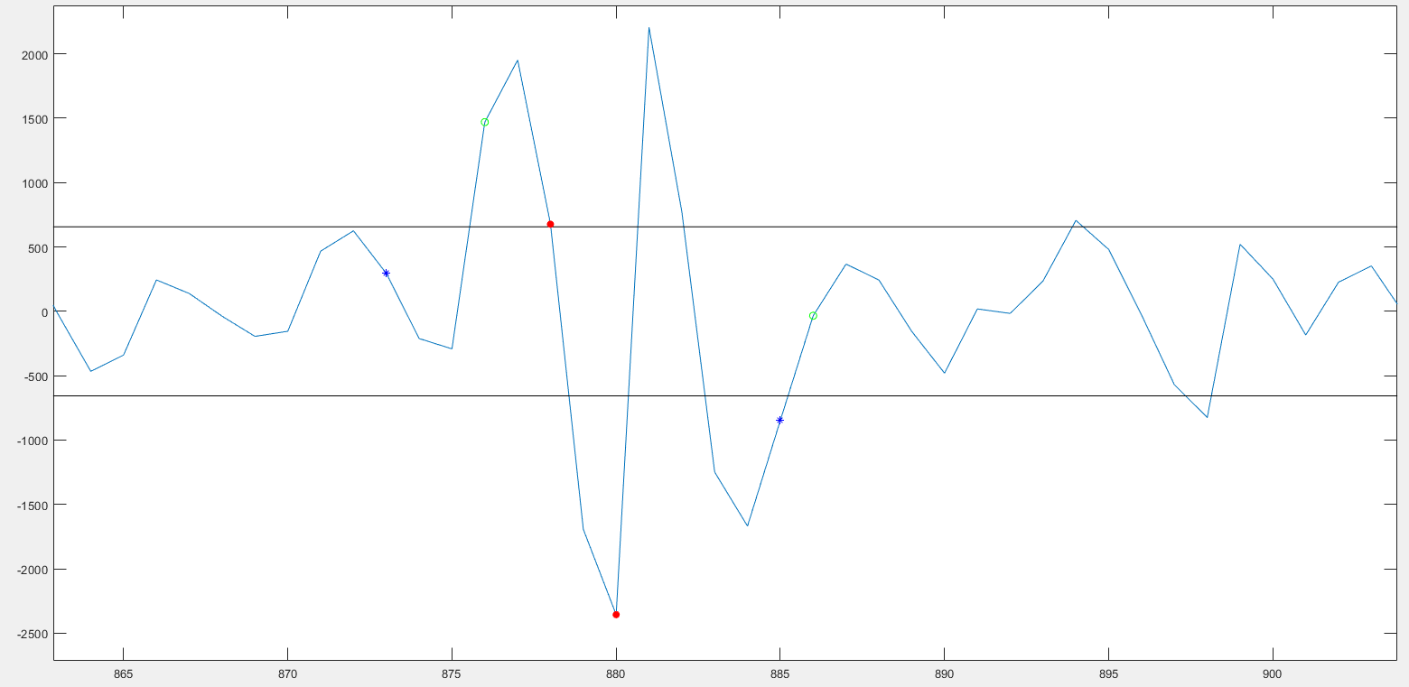
Glitch num. 10
Velocity Vector
Acceleration Vector

Slide 33
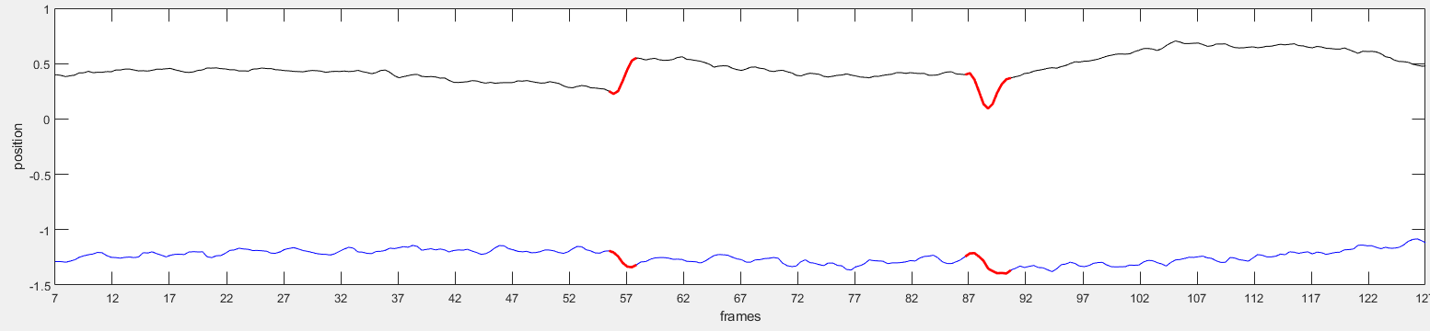
Glitch num. 11
Cortex Trial | CondsX1 Trial | Onset Frame | Offset Frame | Amp (max) | Direction (vecAverage) | Velocity
361 | 35 | 86 | 90 | 0.37 | 193.2 | 24.13
Time Course Figure

Slide 34
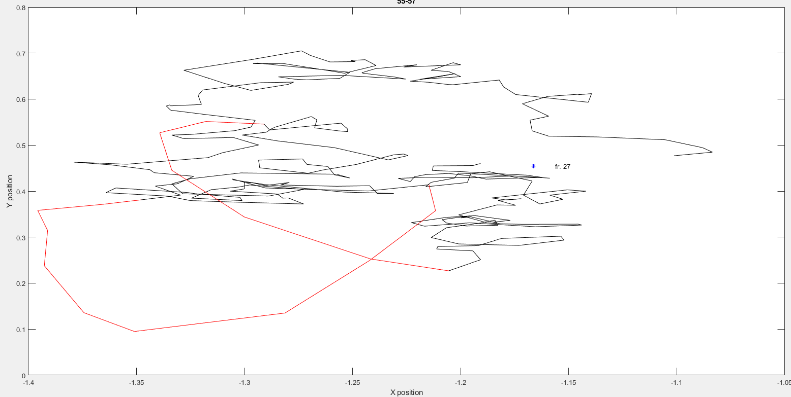
Glitch num. 11
Spatial EM

Slide 35
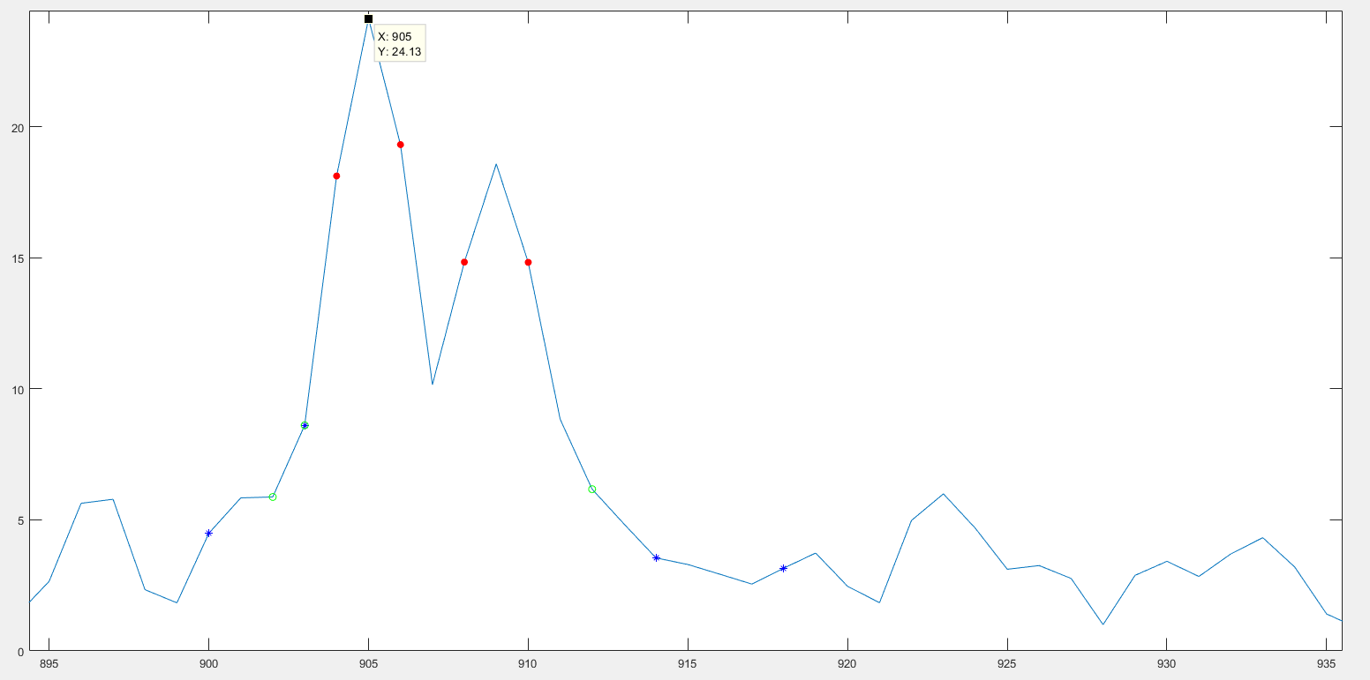
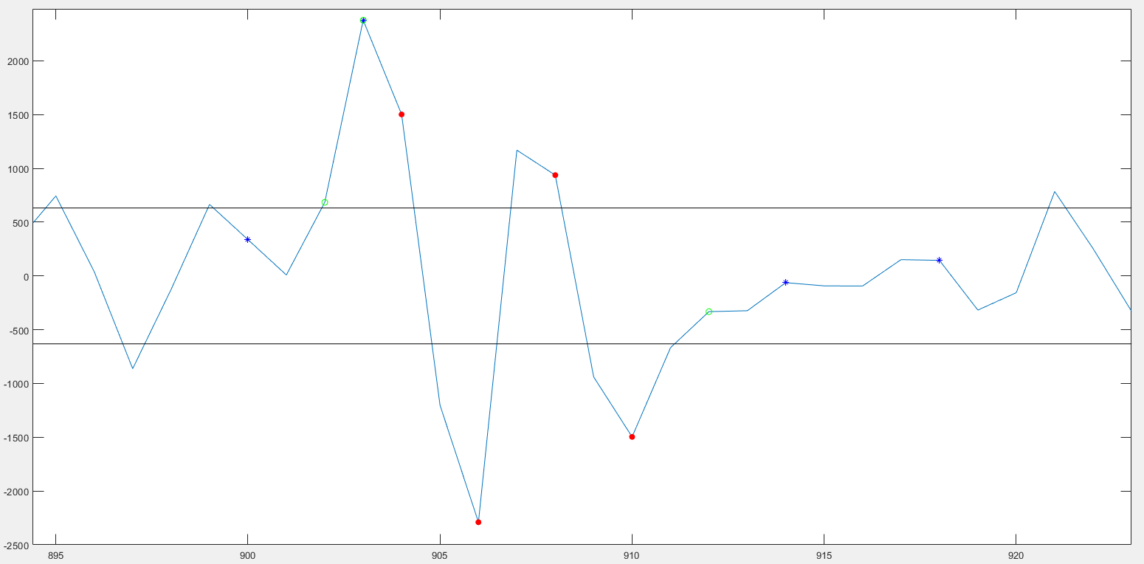
Glitch num. 11
Velocity Vector
Acceleration Vector

Slide 36
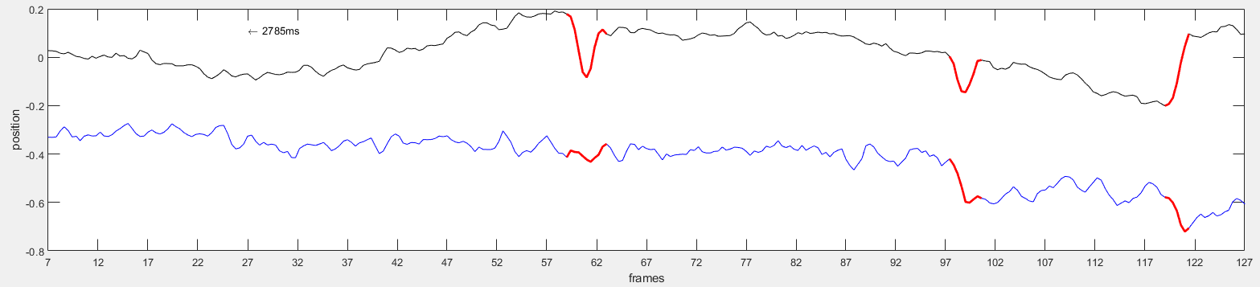
Glitch num. 12
Cortex Trial | CondsX1 Trial | Onset Frame | Offset Frame | Amp (max) | Direction (vecAverage) | Velocity
401 | 37 | 59 | 63 | 0.27 | -55.93 | 17.88
Time Course Figure

Slide 37
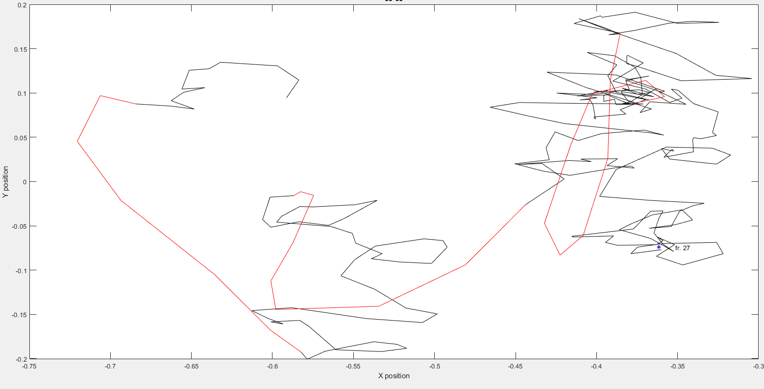
Glitch num. 12
Spatial EM

Slide 38
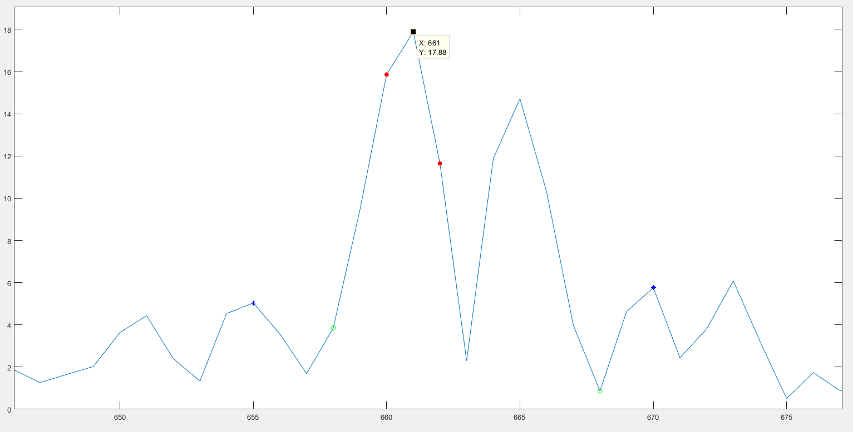
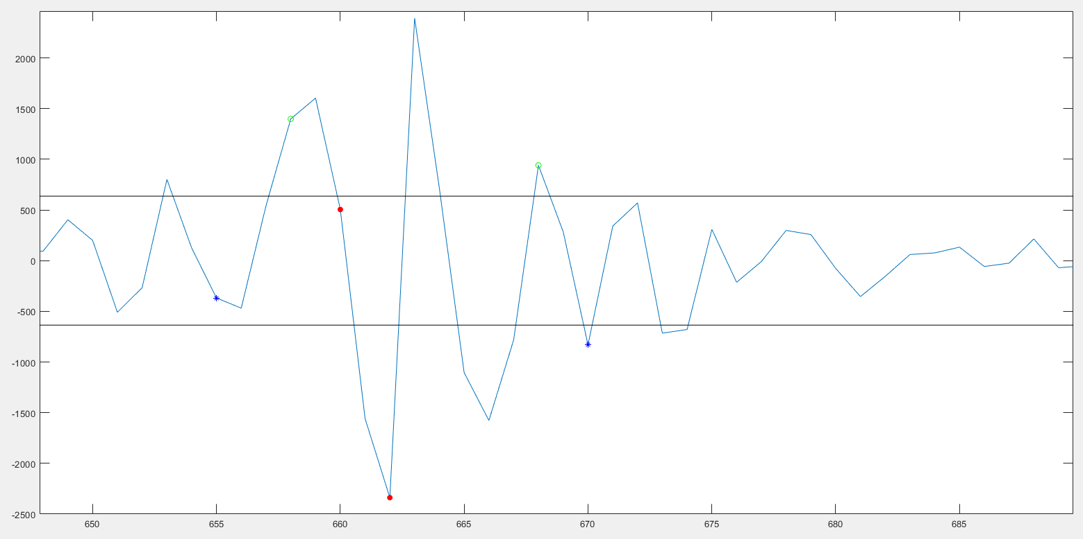
Glitch num. 12
Velocity Vector
Acceleration Vector

Slide 39
Step Total: 10

Slide 40
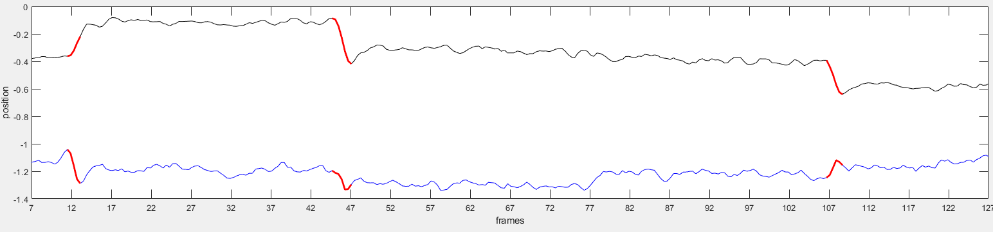
Step num. 1
Cortex Trial | CondsX1 Trial | Onset Frame | Offset Frame | Amp (max) | Direction (vecAverage) | Velocity
41 | 5 | 106 | 108 | 0.28 | -47.98 | 17.77
Time Course Figure

Slide 41
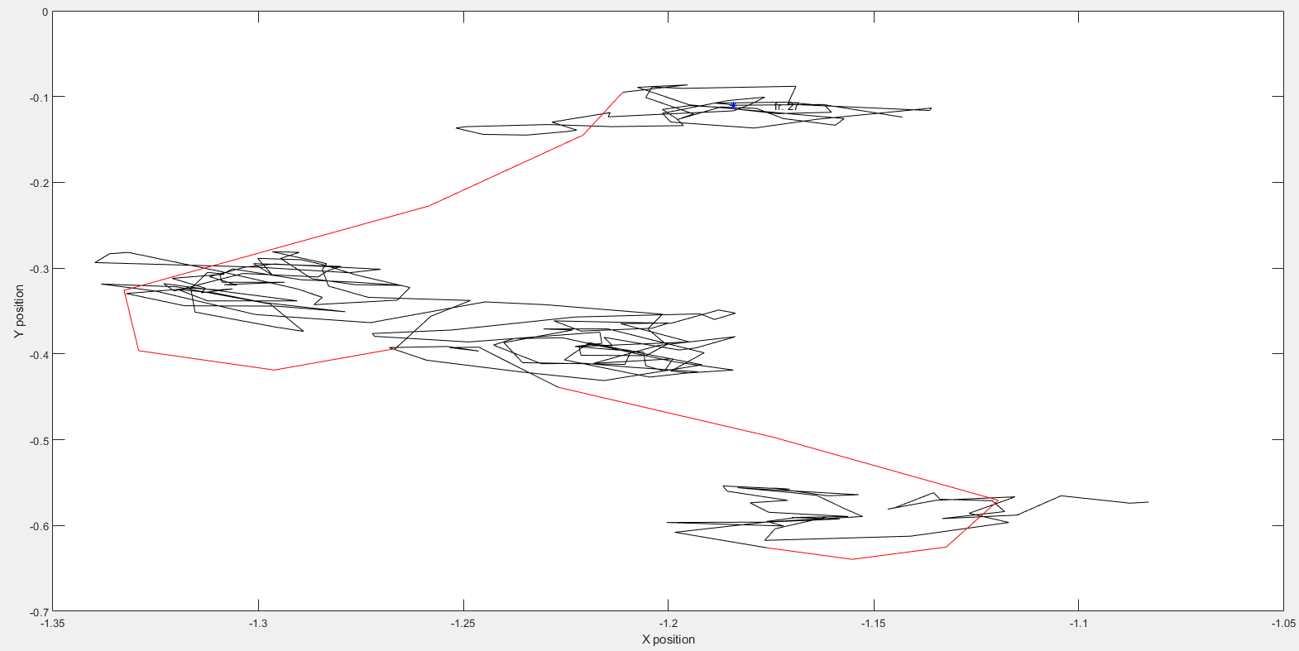
Step num. 1
Spatial EM

Slide 42


Step num. 1
Velocity Vector
Acceleration Vector

Slide 43

Step num. 2
Cortex Trial | CondsX1 Trial | Onset Frame | Offset Frame | Amp (max) | Direction (vecAverage) | Velocity
50 | 6 | 81 | 84 | 0.42 | 63.8 | 23.68
Time Course Figure

Slide 44

Step num. 2
Spatial EM

Slide 45


Step num. 2
Velocity Vector
Acceleration Vector

Slide 46

Step num. 3
Cortex Trial | CondsX1 Trial | Onset Frame | Offset Frame | Amp (max) | Direction (vecAverage) | Velocity
89 | 10 | 107 | 110 | 0.38 | 99.77 | 20.91
Time Course Figure

Slide 47

Step num. 3
Spatial EM

Slide 48


Step num. 3
Velocity Vector
Acceleration Vector

Slide 49

Step num. 4
Cortex Trial | CondsX1 Trial | Onset Frame | Offset Frame | Amp (max) | Direction (vecAverage) | Velocity
119 | 13 | 75 | 78 | 0.19 | 54.56 | 10.56
Time Course Figure

Slide 50

Step num. 4
Spatial EM

Slide 51


Step num. 4
Velocity Vector
Acceleration Vector

Slide 52

Step num. 5
Cortex Trial | CondsX1 Trial | Onset Frame | Offset Frame | Amp (max) | Direction (vecAverage) | Velocity
141 | 15 | 91 | 93 | 0.3 | 232.03 | 19.92
Time Course Figure

Slide 53

Step num. 5
Spatial EM

Slide 54


Step num. 5
Velocity Vector
Acceleration Vector

Slide 55

Step num. 6
Cortex Trial | CondsX1 Trial | Onset Frame | Offset Frame | Amp (max) | Direction (vecAverage) | Velocity
240 | 22 | 68 | 72 | 0.28 | 174.46 | 17.91
Time Course Figure

Slide 56


Step num. 6
K-means Figure
Spatial EM
According to the k means, it’s a step

Slide 57


Step num. 6
Velocity Vector
Acceleration Vector

Slide 58

Step num. 7
Cortex Trial | CondsX1 Trial | Onset Frame | Offset Frame | Amp (max) | Direction (vecAverage) | Velocity
307 | 28 | 82 | 84 | 0.26 | 100.28 | 16.88
Time Course Figure

Slide 59

Step num. 7
Spatial EM

Slide 60


Step num. 7
Velocity Vector
Acceleration Vector

Slide 61

Step num. 8
Cortex Trial | CondsX1 Trial | Onset Frame | Offset Frame | Amp (max) | Direction (vecAverage) | Velocity
339 | 32 | 79 | 82 | 0.38 | 126.06 | 24.91
Time Course Figure

Slide 62

Step num. 8
Spatial EM

Slide 63


Step num. 8
Velocity Vector
Acceleration Vector

Slide 64
Step num. 9
Cortex Trial | CondsX1 Trial | Onset Frame | Offset Frame | Amp (max) | Direction (vecAverage) | Velocity
361 | 35 | 55 | 57 | 0.36 | 112.84 | 22.59
Time Course Figure

Slide 65
Step num. 9
Spatial EM

Slide 66


Step num. 9
Velocity Vector
Acceleration Vector

Slide 67

Step num. 10
Cortex Trial | CondsX1 Trial | Onset Frame | Offset Frame | Amp (max) | Direction (vecAverage) | Velocity
375 | 36 | 91 | 93 | 0.31 | 76.7 | 19.24
Time Course Figure

Slide 68

Step num. 10
Spatial EM

Slide 69


Step num. 10
Velocity Vector
Acceleration Vector

Slide 70
Drift Total: 22

Slide 71

Drift num. 1
Cortex Trial | condsX1 trial | Onset frame | Offset frame | Amp (max) | Direction (vecAverage) | Velocity
25 | 4 | 66 | 68 | 0.35 | 104.36 | 22.53
Time Course Figure

Slide 72

Drift num. 1
Spatial EM

Slide 73


Drift num. 1
Velocity Vector
Acceleration Vector

Slide 74

Drift num. 2
Cortex Trial | CondsX1 Trial | Onset Frame | Offset Frame | Amp (max) | Direction (vecAverage) | Velocity
89 | 10 | 41 | 44 | 0.4 | -51.69 | 25.6
Time Course Figure

Slide 75
Drift num. 2
Spatial EM

Slide 76


Drift num. 2
Velocity Vector
Acceleration Vector

Slide 77

Drift num. 3
Cortex Trial | CondsX1 Trial | Onset Frame | Offset Frame | Amp (max) | Direction (vecAverage) | Velocity
97 | 11 | 82 | 86 | 0.46 | 69.97 | 28.21
Time Course Figure

Slide 78

Drift num. 3
Spatial EM

Slide 79


Drift num. 3
Velocity Vector
Acceleration Vector

Slide 80
Drift num. 4
Cortex Trial | CondsX1 Trial | Onset Frame | Offset Frame | Amp (max) | Direction (vecAverage) | Velocity
97 | 11 | 109 | 111 | 0.24 | 99.02 | 14.99
Time Course Figure

Slide 81
Drift num. 4
Spatial EM

Slide 82


Drift num. 4
Velocity Vector
Acceleration Vector

Slide 83

Drift num. 5
Cortex Trial | CondsX1 Trial | Onset Frame | Offset Frame | Amp (max) | Direction (vecAverage) | Velocity
119 | 13 | 42 | 46 | 0.37 | 164.61 | 24.38
Time Course Figure

Slide 84

Drift num. 6
Spatial EM

Slide 85


Drift num. 6
Velocity Vector
Acceleration Vector

Slide 86

Drift num. 7
Cortex Trial | CondsX1 Trial | Onset Frame | Offset Frame | Amp (max) | Direction (vecAverage) | Velocity
226 | 21 | 81 | 83 | 0.23 | 174.83 | 16.88
Time Course Figure

Slide 87

Drift num. 7
Spatial EM

Slide 88


Drift num. 7
Velocity Vector
Acceleration Vector

Slide 89
Drift num. 8
Cortex Trial | CondsX1 Trial | Onset Frame | Offset Frame | Amp (max) | Direction (vecAverage) | Velocity
307 | 28 | 46 | 50 | 0.46 | -80.3 | 30.26
Time Course Figure

Slide 90
Drift num. 8
Spatial EM

Slide 91


Drift num. 8
Velocity Vector
Acceleration Vector

Slide 92

Drift num. 9
Cortex Trial | CondsX1 Trial | Onset Frame | Offset Frame | Amp (max) | Direction (vecAverage) | Velocity
347 | 33 | 66 | 68 | 0.51 | -65.36 | 34.68
Time Course Figure

Slide 93

Drift num. 9
Spatial EM

Slide 94


Drift num. 9
Velocity Vector
Acceleration Vector

Slide 95

Glitch with Drift num. 1
Cortex Trial | CondsX1 Trial | Onset Frame | Offset Frame | Amp (max) | Direction (vecAverage) | Velocity
9 | 2 | 114 | 118 | 0.23 | 135.58 | 15.02
Time Course Figure

Slide 96

Glitch with Drift num. 1
Spatial EM

Slide 97


Glitch with Drift num. 1
Velocity Vector
Acceleration Vector

Slide 98

Glitch with Drift num. 2
Cortex Trial | CondsX1 Trial | Onset Frame | Offset Frame | Amp (max) | Direction (vecAverage) | Velocity
41 | 5 | 44 | 47 | 0.36 | 77.07 | 22.26
Time Course Figure

Slide 99

Glitch with Drift num. 2
Spatial EM

Slide 100


Glitch with Drift num. 2
Velocity Vector
Acceleration Vector

Slide 101

Glitch with Drift num. 3
Cortex Trial | CondsX1 Trial | Onset Frame | Offset Frame | Amp (max) | Direction (vecAverage) | Velocity
50 | 6 | 99 | 102 | 0.37 | 122.9 | 24.4
Time Course Figure

Slide 102
Glitch with Drift num. 3
Spatial EM

Slide 103


Glitch with Drift num. 3
Velocity Vector
Acceleration Vector

Slide 104

Glitch with Drift num. 4
Cortex Trial | CondsX1 Trial | Onset Frame | Offset Frame | Amp (max) | Direction (vecAverage) | Velocity
105 | 12 | 104 | 108 | 0.48 | 17.06 | 29.25
Time Course Figure

Slide 105

Glitch with Drift num. 4
Spatial EM

Slide 106


Glitch with Drift num. 4
Velocity Vector
Acceleration Vector

Slide 107

Glitch with Drift num. 5
Cortex Trial | CondsX1 Trial | Onset Frame | Offset Frame | Amp (max) | Direction (vecAverage) | Velocity
133 | 14 | 88 | 92 | 0.22 | 211.07 | 13.93
Time Course Figure

Slide 108

Glitch with Drift num. 5
Spatial EM

Slide 109


Glitch with Drift num. 5
Velocity Vector
Acceleration Vector

Slide 110

Glitch with Drift num. 6
Cortex Trial | CondsX1 Trial | Onset Frame | Offset Frame | Amp (max) | Direction (vecAverage) | Velocity
166 | 17 | 71 | 76 | 0.27 | 192.13 | 17.03
Time Course Figure

Slide 111

Glitch with Drift num. 6
Spatial EM

Slide 112


Glitch with Drift num. 6
Velocity Vector
Acceleration Vector

Slide 113

Glitch with Drift num. 7
Cortex Trial | CondsX1 Trial | Onset Frame | Offset Frame | Amp (max) | Direction (vecAverage) | Velocity
271 | 25 | 61 | 65 | 0.36 | 1.59 | 24.99
Time Course Figure

Slide 114

Glitch with Drift num. 7
Spatial EM

Slide 115


Glitch with Drift num. 7
Velocity Vector
Acceleration Vector

Slide 116

Glitch with Drift num. 8
Cortex Trial | CondsX1 Trial | Onset Frame | Offset Frame | Amp (max) | Direction (vecAverage) | Velocity
328 | 30 | 55 | 59 | 0.28 | 151.2 | 17.87
Time Course Figure

Slide 117

Glitch with Drift num. 8
Spatial EM

Slide 118


Glitch with Drift num. 8
Velocity Vector
Acceleration Vector

Slide 119
Glitch with Drift num. 9
Cortex Trial | CondsX1 Trial | Onset Frame | Offset Frame | Amp (max) | Direction (vecAverage) | Velocity
339 | 32 | 54 | 58 | 0.46 | 251.21 | 29.71
Time Course Figure

Slide 120
Glitch with Drift num. 9
Spatial EM

Slide 121


Glitch with Drift num. 9
Velocity Vector
Acceleration Vector

Slide 122

Glitch with Drift num. 10
Cortex Trial | CondsX1 Trial | Onset Frame | Offset Frame | Amp (max) | Direction (vecAverage) | Velocity
375 | 36 | 49 | 52 | 0.43 | -72.36 | 26.75
Time Course Figure

Slide 123

Glitch with Drift num. 10
Spatial EM

Slide 124


Glitch with Drift num. 10
Velocity Vector
Acceleration Vector

Slide 125

Drift with step num. 1
Cortex Trial | CondsX1 Trial | Onset Frame | Offset Frame | Amp (max) | Direction (vecAverage) | Velocity
50 | 6 | 53 | 56 | 0.4 | -53.48 | 24.38
Time Course Figure

Slide 126
Drift with step num. 1
Spatial EM

Slide 127
Drift with step num. 1
Velocity Vector
Acceleration Vector

Slide 128

Drift with step num. 2
Cortex Trial | CondsX1 Trial | Onset Frame | Offset Frame | Amp (max) | Direction (vecAverage) | Velocity
257 | 24 | 44 | 46 | 0.44 | 141.16 | 27.63
Time Course Figure

Slide 129

Drift with step num. 2
Spatial EM

Slide 130


Drift with step num. 2
Velocity Vector
Acceleration Vector

Slide 131

Drift with step num. 3
Cortex Trial | CondsX1 Trial | Onset Frame | Offset Frame | Amp (max) | Direction (vecAverage) | Velocity
285 | 26 | 76 | 78 | 0.31 | 229.82 | 20.92
Time Course Figure

Slide 132

Drift with step num. 3
Spatial EM

Slide 133


Drift with step num. 3
Velocity Vector
Acceleration Vector

